Slide 1
Biol 7200: Programming for Bioinformatics Exercise 4 demos

Slide 2
Demo plan
Demos/discussion
Broken code

Slide 3
Demo plan again this week
Volunteers will be picked now
Email me your script (biol7200.gt@gmail.com)
I’ll run it and show it (if it fails another volunteer will be selected – be ready to send!)
You walk us through it
ALL BASH IS ACCEPTABLE (no Python)

Slide 4
Things being demoed
Ex4 script

Slide 5
Identify_homologs.sh
#!/bin/bash
#file assignment
query="$1"
subject="$2"
bedfile="$3"
outfile="$4"
#perform BLAST with task and output format 6 with std + qlen (13 culumns) -> copy only homologs to output
tblastn -query $query -subject $subject -task tblastn -outfmt "6 std qlen" | awk '$3 > 30 && $4 > $13*0.9' | awk '{print $9, $10}' > homolog_coordinates
> output
while read homolog_start homolog_end
do
while read chr bed_start bed_stop bed_gn dot sign
do
#Find sequence features that contain start/end positions of homolog file
if [[ $homolog_start -gt $bed_start ]] && [[ $homolog_end -le $bed_stop ]]
then
#Output gene names of the matched squence features
echo $bed_gn >> output
fi
done < $bedfile
done < homolog_coordinates
#sort the file and output only unique gene name values to the output file
sort output | uniq > $outfile
#remove the temporary file
rm output
rm homolog_coordinates
# Print the number of matches to stdout
echo "Number of homolog matches in $bedfile: "$(wc -l < $outfile)""

Slide 6
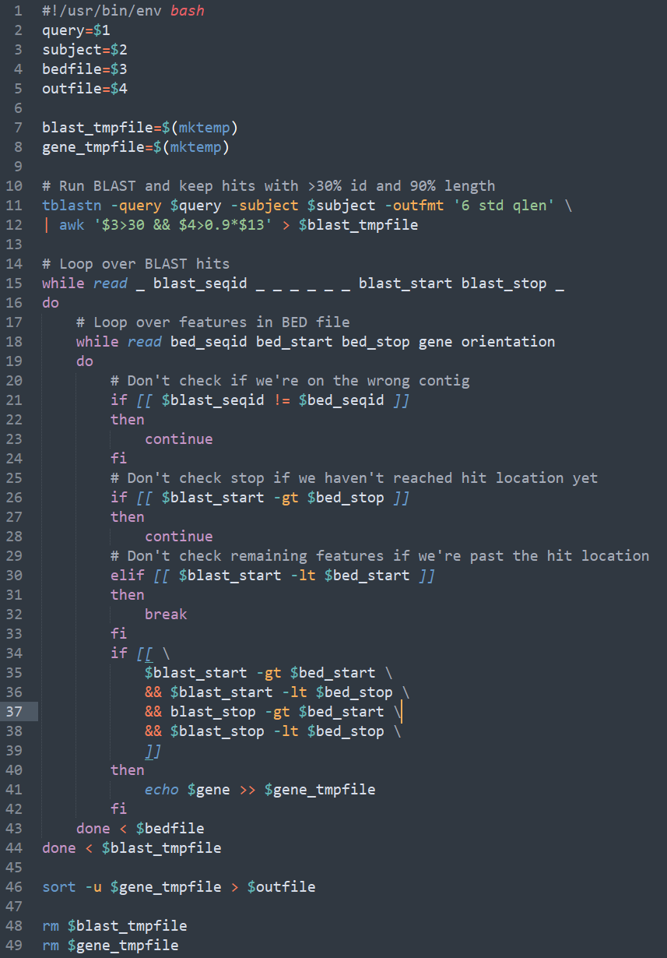
Identify_homologs.sh – my solution
Notes:
#!/usr/bin/env bash
query=$1
subject=$2
bedfile=$3
outfile=$4
blast_tmpfile=$(mktemp)
gene_tmpfile=$(mktemp)
# Run BLAST and keep hits with >30% id and 90% length
tblastn -query $query -subject $subject -outfmt '6 std qlen' \
| awk '$3>30 && $4>0.9*$13' > $blast_tmpfile
# Loop over BLAST hits
while read _ blast_seqid _ _ _ _ _ _ blast_start blast_stop _
do
# Loop over features in BED file
while read bed_seqid bed_start bed_stop gene orientation
do
# Don't check if we're on the wrong contig
if [[ $blast_seqid != $bed_seqid ]]
then
continue
fi
# Don't check stop if we haven't reached hit location yet
if [[ $blast_start -gt $bed_stop ]]
then
continue
# Don't check remaining features if we're past the hit location
elif [[ $blast_start -lt $bed_start ]]
then
break
fi
if [[ $blast_start -gt $bed_start
&& $blast_start -lt $bed_stop \
&& blast_stop -gt $bed_start \
&& $blast_stop -lt $bed_stop \
]]
then
echo $gene >> $gene_tmpfile
fi
done < $bedfile
done < $blast_tmpfile
sort -u $gene_tmpfile > $outfile
rm $blast_tmpfile
rm $gene_tmpfile

Slide 7
End of demos
Next, broken code

Slide 8
Broken code structure reminder
What’s it trying to do?
What’s wrong with it?
How would you fix it?

Slide 9
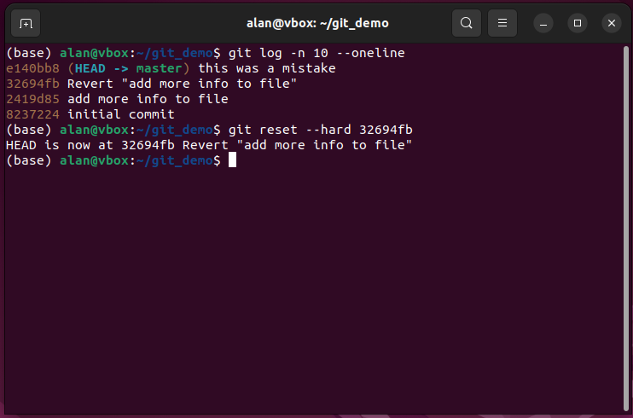
Broken code 1
What’s it trying to do?
What’s wrong with it?
How would you fix it?

Slide 10
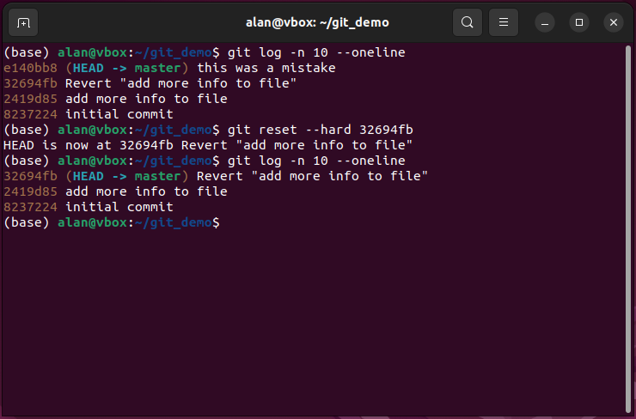
Broken code 1
What’s it trying to do?
Undo a bad commit
What’s wrong with it?
Reset deletes part of your git history. This causes issues in shared repos as your history will conflict with others
How would you fix it?
Use revert instead to add a negating commit

Slide 11
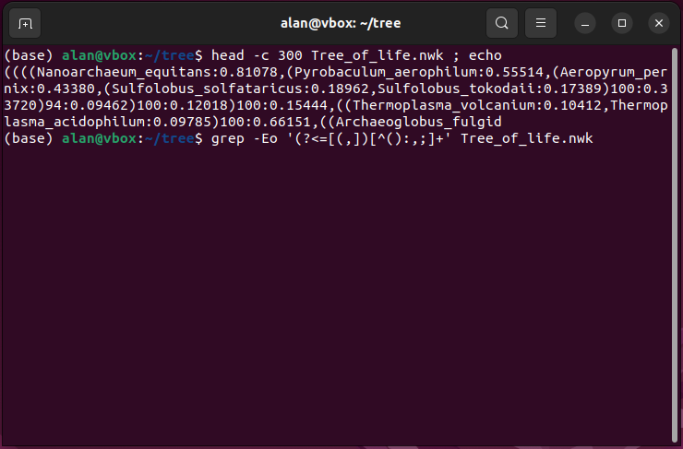
Broken code 2
What’s it trying to do?
What’s wrong with it?
How would you fix it?

Slide 12
Broken code 2
What’s it trying to do?
Extract leaf names from newick tree
What’s wrong with it?
Using GNU ERE not PCRE
How would you fix it?
Use –P option for grep

Slide 13
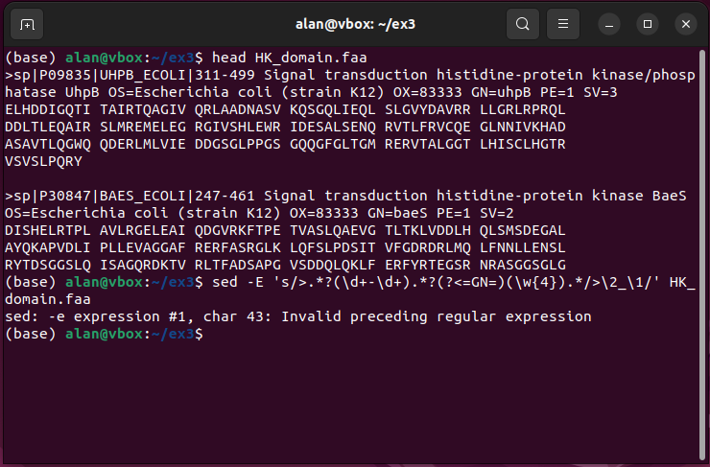
Broken code 3
What’s it trying to do?
What’s wrong with it?
How would you fix it?

Slide 14
Broken code 3
What’s it trying to do?
Modify headers using a regex
What’s wrong with it?
Sed doesn’t support PCRE so no lookarounds, \w and \d
How would you fix it?
Don’t use lookarounds. Instead just put the anchoring sequence outside the match group. Use [0-9] instead of \d and [A-Za-z0-9_] instead of \w

Slide 15
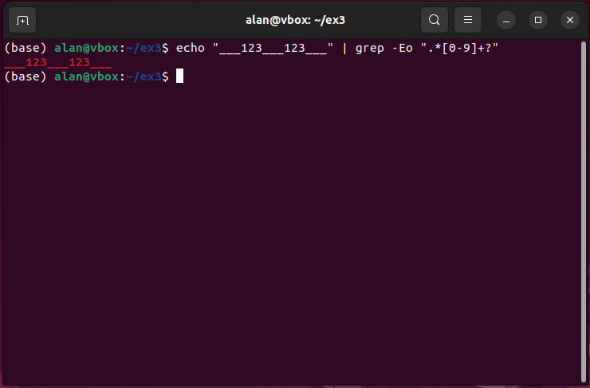
Broken code 4
What’s it trying to do?
What’s wrong with it?
How would you fix it?

Slide 16
Broken code 4
What’s it trying to do?
Teach a class
What’s wrong with it?
? Is makes quantifiers lazy in PCRE but wasn’t expected to do anything in GNU ERE
How would you fix it?
Use –P option for grep

Slide 17
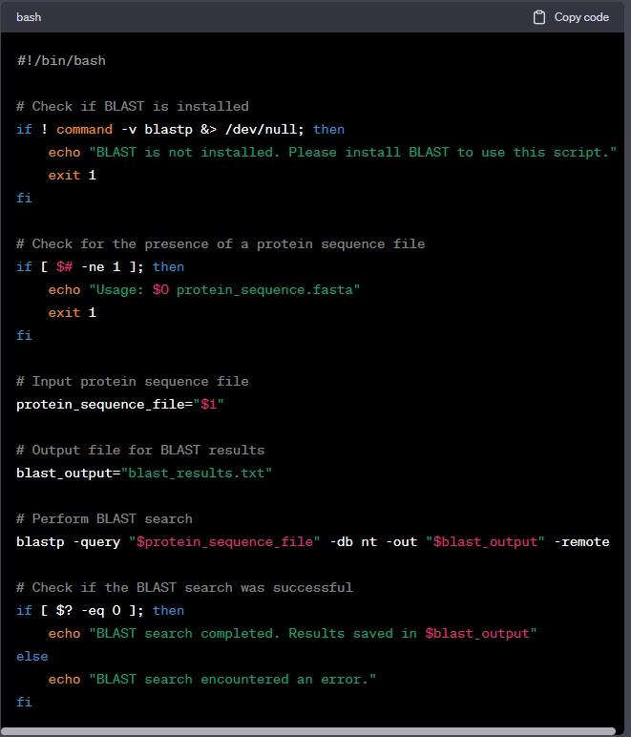
Broken code 5
What’s it trying to do?
What’s wrong with it?
How would you fix it?
“Write a bash script that take a protein sequence and identifies possible homologs in a nucleotide sequence”

Slide 18
Broken code 5
What’s it trying to do?
What it was told
What’s wrong with it?
BLASTP is the wrong tool for protein vs DNA
It’s blasting against the remote NCBI database
How would you fix it?
Write it myself and use tblastn
Don’t echo additional errors when the error message will already be printed from BLAST

Slide 19
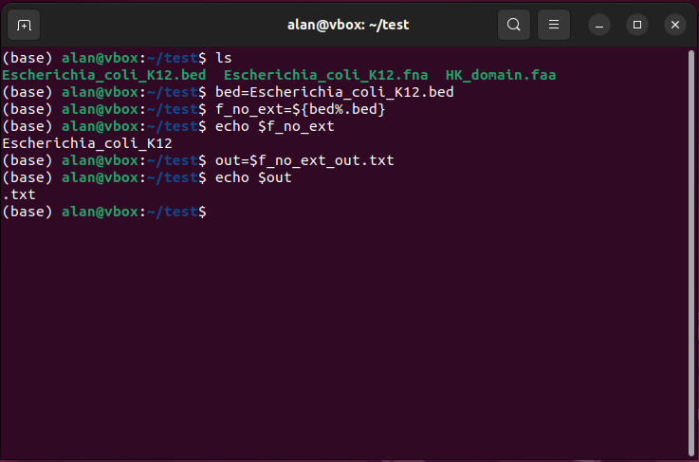
Broken code 6
What’s it trying to do?
What’s wrong with it?
How would you fix it?

Slide 20
Broken code 6
What’s it trying to do?
Create a variable containing a modification of another variable
What’s wrong with it?
“_” is a valid character in a variable name so Bash looks for a variable called “f_no_ext_out”
How would you fix it?
Use quotes or {} to separate variable name from rest of string

Slide 21
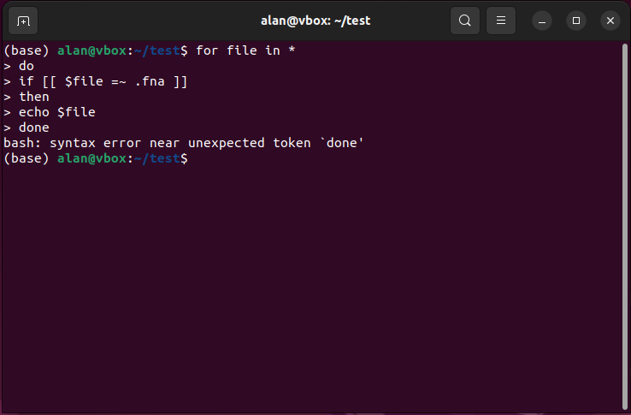
Broken code 7
What’s it trying to do?
What’s wrong with it?
How would you fix it?

Slide 22
Broken code 7
What’s it trying to do?
Loop over files and print those containing “.fna” in their name
What’s wrong with it?
If conditions must be ended using “fi”
How would you fix it?
Add “fi” to indicate the end of the if block

Slide 23
Back to Tuesday’s script

